Slide 1
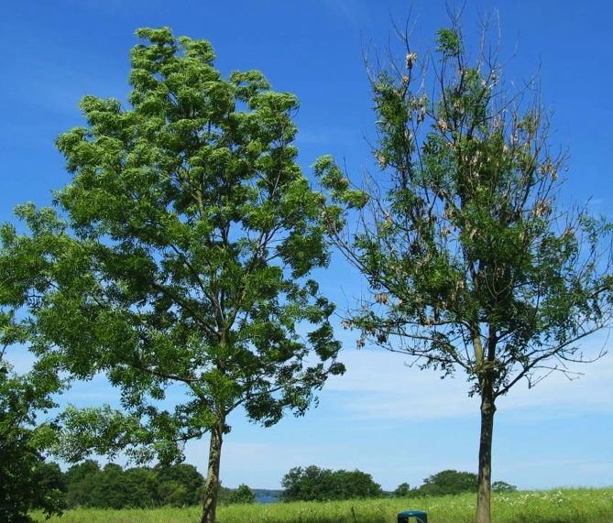


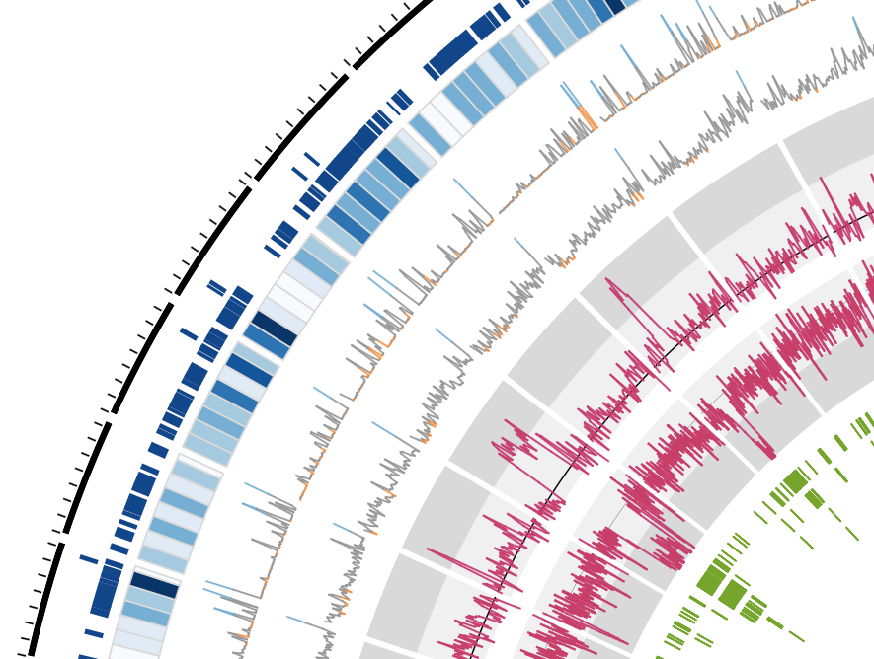
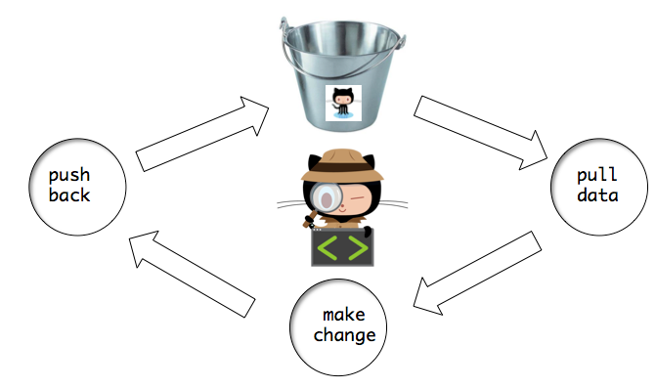
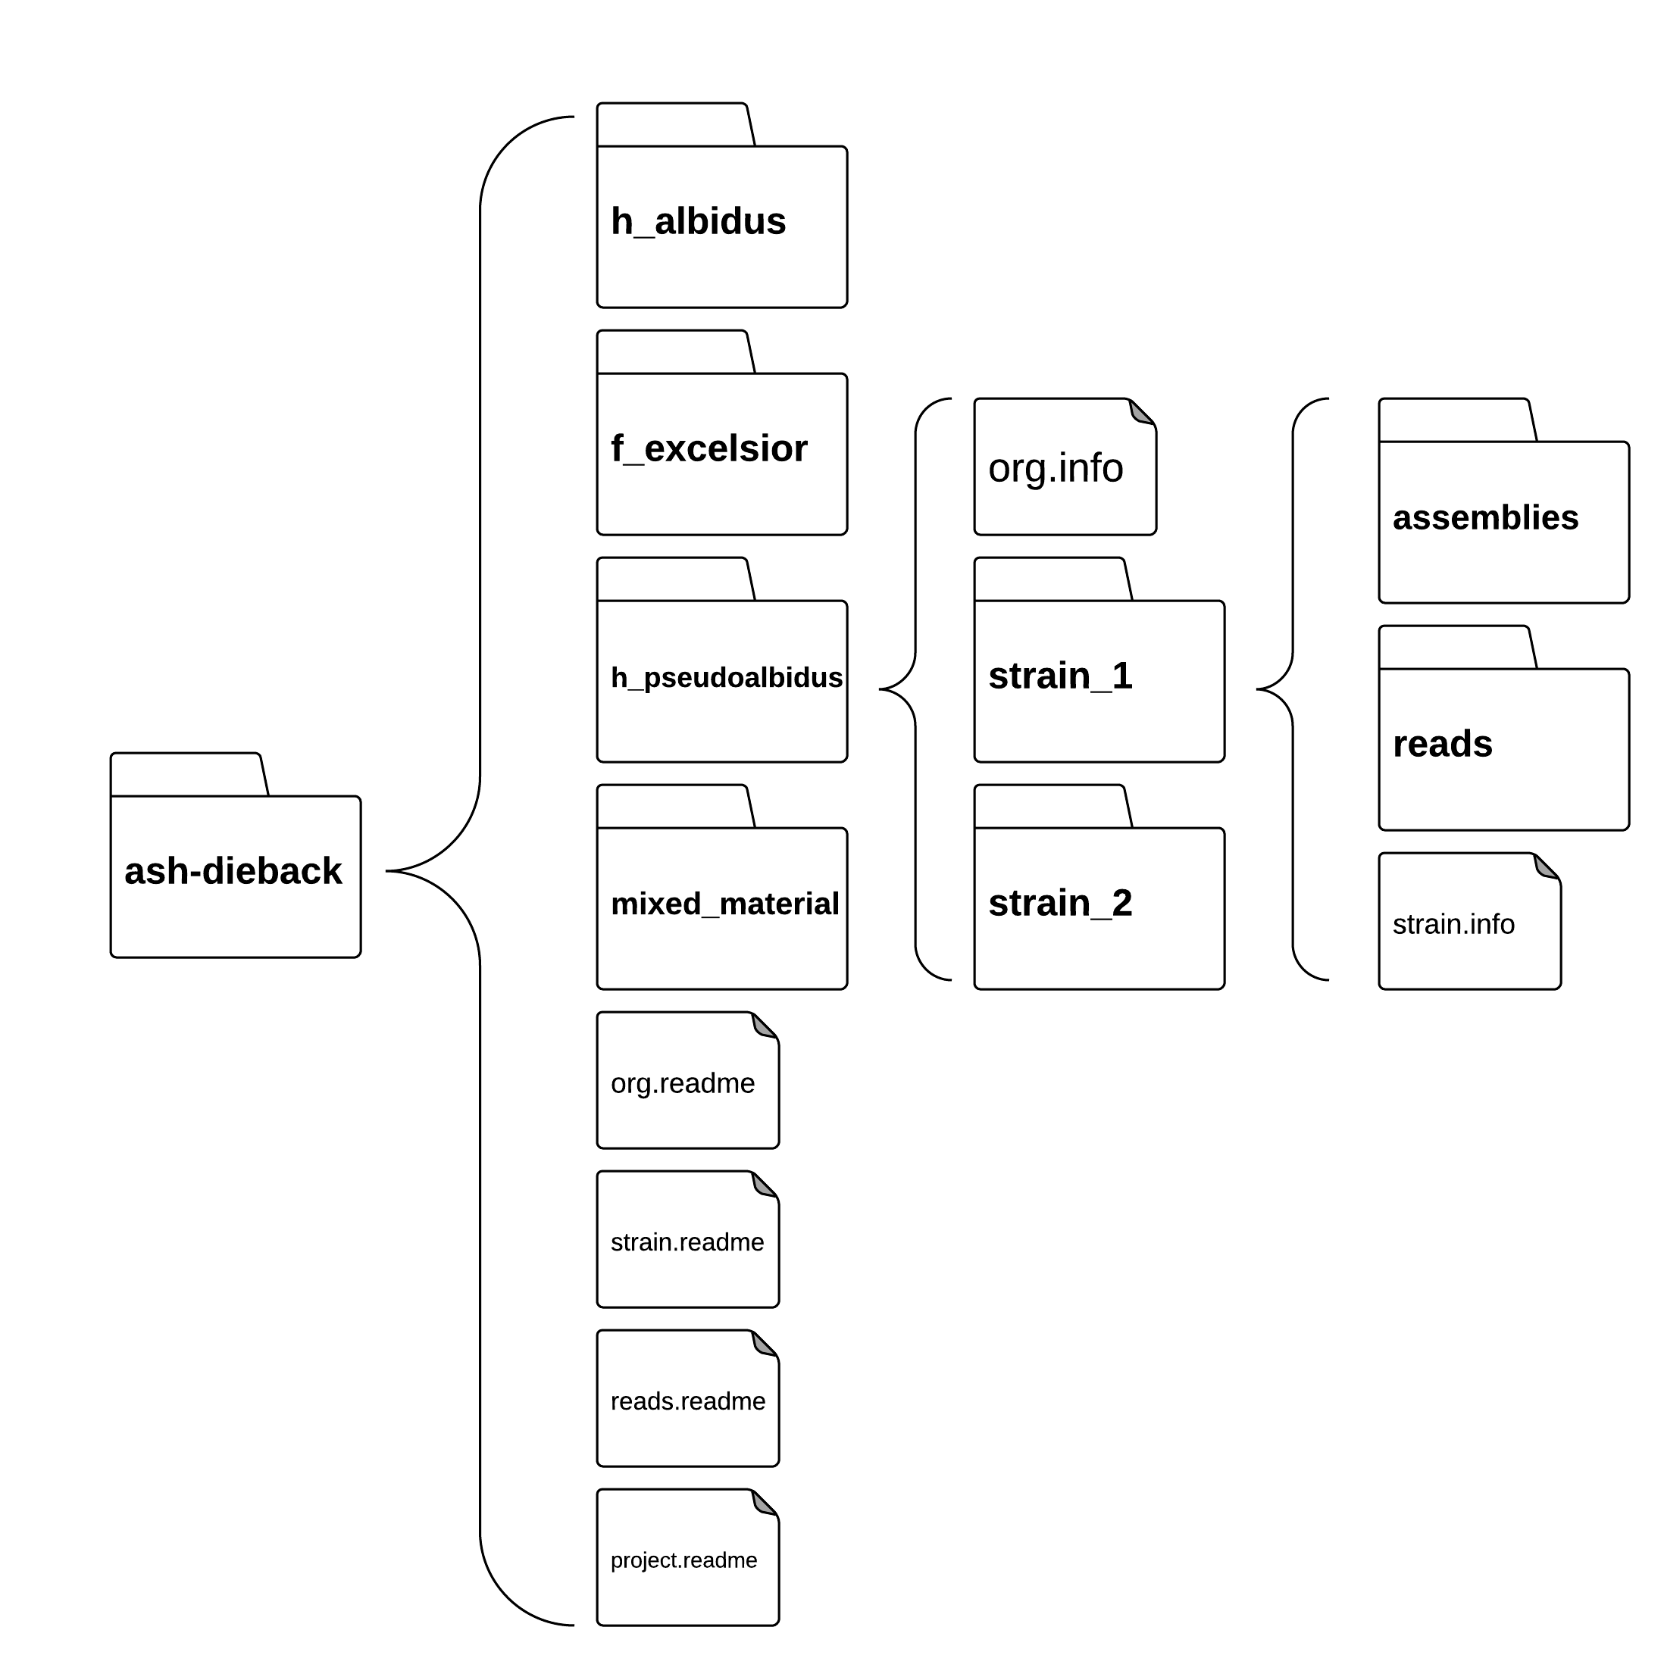
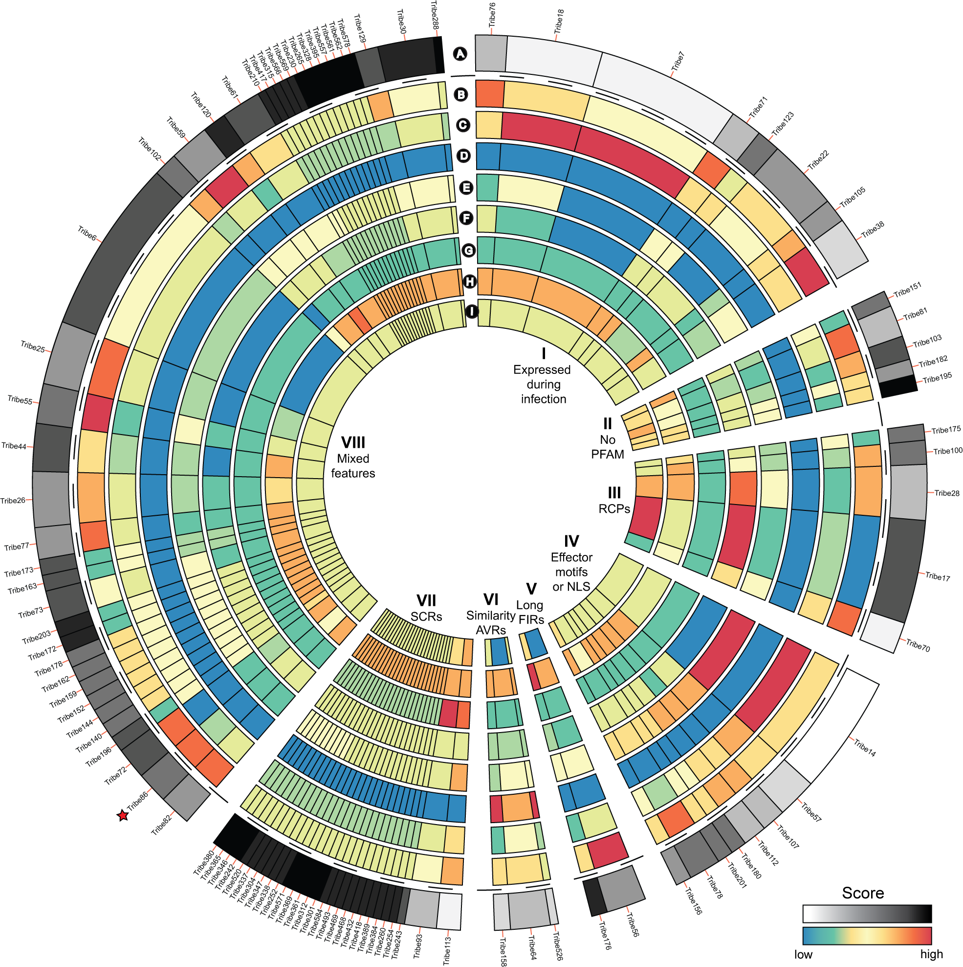
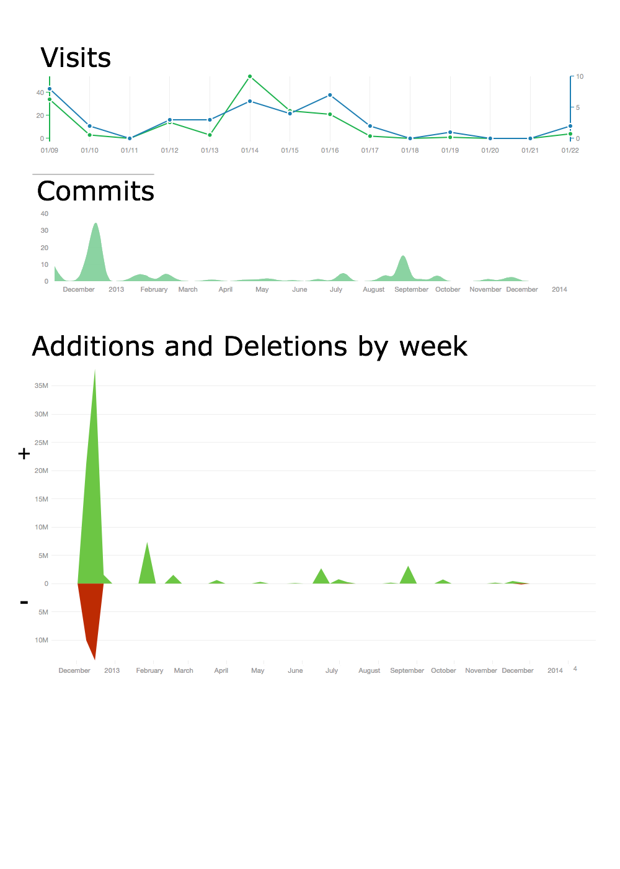
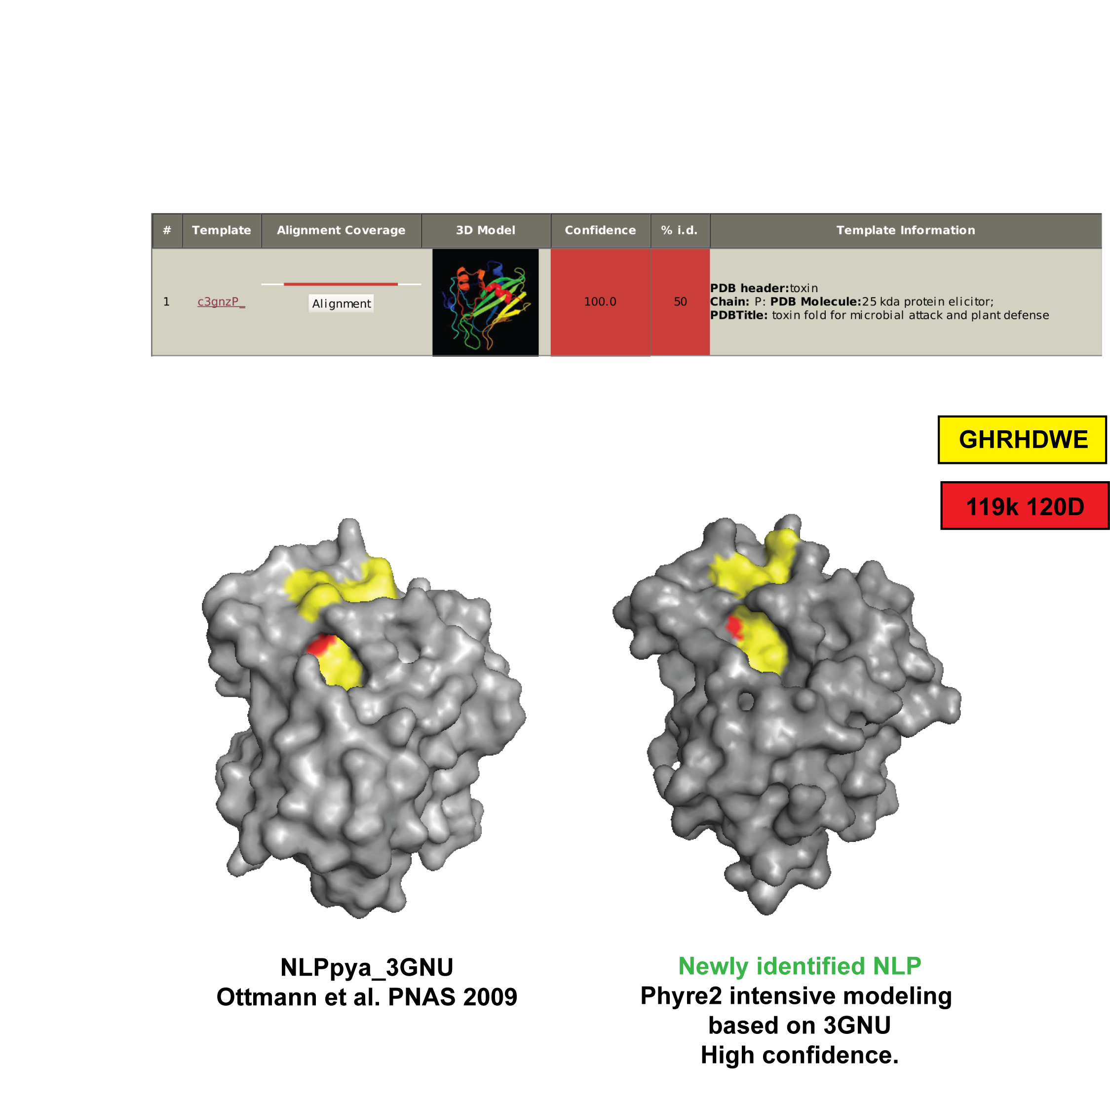
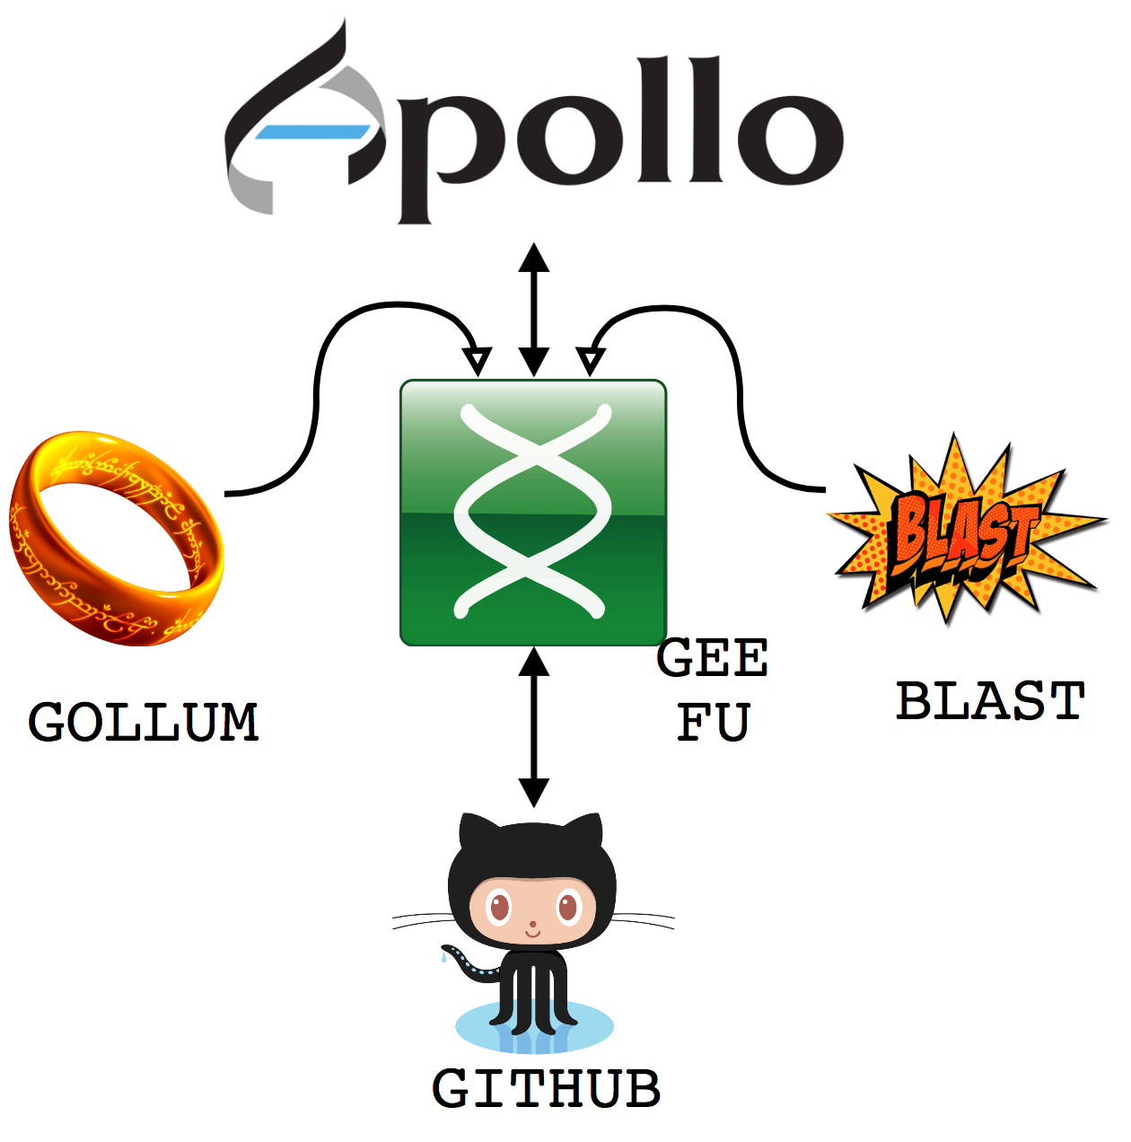







CROWDSOURCING EMERGENT PATHOGENOMICS
Ash Dieback
Story by: Kentaro Yoshida, Diane Saunders, Suomeng Dong, Allan J. Downie, Sophien Kamoun and Dan MacLean. dan.maclean@tsl.ac.uk
Science is bad at responding quickly to change. Grant and publication concerns inhibit us from sharing and collaborating openly. We took a crowdsourcing approach to kickstart research into ash dieback, a new model that relies on group contributions and open data. We released data and analyses direct to anyone through our hub website at OpenAshDieBack http://oadb.tsl.ac.uk
Ash dieback – caused by Hymenoscyphus pseudoalbidus – is a potent pathogen of ash trees. It causes crown dieback, lesions and cankers on stems and can kill young trees.
Ash dieback arrived in the UK in late 2012 and spread across the country in under a year. 90% of UK ash is under threat of infection. Ash dieback is a potent, fast moving, emergent pathogen!!
RESULTS ON OADB
A genome assembly of H.pseudoalbidus was provided by TGAC in Norwich. The approximately 63 Mb genome assembly is in 1672 scaffolds with N50 of 70.5 Kb. The draft genome assembly has been annotated and has an interesting structure. The peaks of back-aligned read coverage and drops in GC content (pink tracks) indicate a repeat-rich, collapsed assembly. Suggestive of a complex genome with many repeat-rich sections. See this figure in more detail at: http://dx.doi.org/10.6084/m9.figshare.791640
OADB.TSL.AC.UK – A HUB FOR AN ACTIVE COMMUNITY
The data is held in Git. A version control system that manages changes to filesets and tracks contributions very closely. It has a simple ‘pull – change – push’ mechanism that aids work by many collaborators at one time.
The database is based on a simple semantic folder structure. It is easy to specify experimental metadata and find the data you need, everything has a ‘right’ place.
Candidate effectors were catalogued by identifying potentially secreted proteins using SignalP 4 and NLStradamus. Mitochondrial target proteins and transmembrane domain proteins were removed using TMHMM and TargtP. All proteins were clustered with OrthoMCL, creating 593 ‘tribes’ with at least one secreted protein. These were annotated for known effector features as described in more detail at: http://oadb.tsl.ac.uk/?p=622
We have a large and active community. We have had more than 140 contributions over 12 months, representing many millions of lines of analysis results (not raw data). We have 37 blog posts on http://oadb.tsl.ac.uk
MANY
MORE DATASETS ON OADB
Fungal and oomycete Nep1-like protein (NLP) sequences from public databases were used in tblastn against OADB data and revealed a H.pseudolbidus transcript with high similarity to NLPs. The protein sequence was then used for structure modeling, with the published NLPpya 3GNU as a template. The predicted protein we identified carries all the key residues for NLP cytolytic function (red ones). See also: http://oadb.tsl.ac.uk/?p=235
GEEFU – NEW TOOLS FOR ALL CONTRIBUTORS
>25 H.pseudoalbidus isolate genomes
(from UK
>25 H.pseudoalbidus transcriptomes
(from UK, France and Japan)
2 Ash genomes, from UK and Denmark
2 Ash transcriptomes, from UK
Assemblies of each of the above
To crowdsource from a wider crowd we have developed new tools to take contributions from specialists outside of genomics. We built GeeFu (geefu.oadb.tsl.ac.uk) – a crowdsourcing genome browser that incorporates common graphical interfaces for feature editing, BLAST functions and Wiki capability.
CROWDSOURCING – A GREAT WAY TO LAUNCH NEW PROJECTS
Our crowdsourcing approach really kickstarted the study of genomics of Hymenoscyphus pseudoalbidus. The early availability of and easy access to data brought in a lot of analysis from across the world and a great deal was learned in a short time.
We reached bioinformaticians, genomicists and bench and field biologists by making the data available in forms that each could use.
To read this story in more detail please see our pre-print at
http://biorxiv.org/content/early/2014/04/25/004564
GeeFu coordinates automatic exchange and concurrency of data between the apps and Git, making sure that contributions from these other tools are tracked into the main OADB repository.
All links in this poster available through: http://tinyurl.com/danmaclean

